Slide 1
Defense Behavior of Real-Time Strategy Games: Comparison between HFSM and FSM
Presenter: Mingwei Zhang
Affiliation: Queens College
Advisor: Robert Goldberg

Slide 2
Abstract
In Real-Time Strategy (RTS), defense towers traditionally attack the nearest enemy without evaluating important factors, which makes them predictable and vulnerable to coordinated attacks.
This study investigates how using a Hierarchical Finite State Machine (HFSM) can improve tower defense behavior compared to a standard Finite State Machine (FSM).
The HFSM model allows towers to assess multiple parameters, including their own health, the enemy's health, enemy type, and distance, to make more strategic attack decisions. Depending on the situation, the towers can choose between aggressive attacks, regular attacks, or special skills.
Simulation results demonstrated that towers utilizing HFSM generally outperformed those using FSM, particularly for the Kamandaka and Adikara towers, which achieved notable improvements in defense performance.

Slide 3
Introduction
RTS games are highly interactive and strategic, combining combat, resource management, and tactical planning.
A key feature of RTS gameplay is the use of Non-Playable Character (NPC) defense towers, which automatically protect player bases by attacking incoming enemies.
Traditionally, NPC towers target the nearest enemy automatically, without considering enemy type, health, or distance.
This simplistic targeting behavior makes tower defenses predictable and vulnerable to coordinated group attacks.
Improving NPC decision-making by evaluating multiple factors could greatly enhance player engagement and add greater strategic depth to gameplay.

Slide 4
Background
The primary issue addressed in this research is the predictable nature of NPC tower behavior in RTS games, specifically:
Standard NPC towers typically attack the nearest enemy without evaluating critical factors such as enemy strength, distance, or type.
This can lead to vulnerabilities, especially against coordinated group attacks.
Historically, game developers use simple methods like the FSM to control NPC behavior because it is straightforward to implement.
However, FSMs can become limited and overly complex when managing numerous and changing conditions.
Alternative methods, such as the HFSM, offer a structured, layered approach, enabling towers to adapt their behavior based on evolving game scenarios.

Slide 5
Defining The Problem
The issue is in RTS games, NPC defense towers commonly use a simple targeting mechanism: they attack the nearest enemy without considering other important factors like the enemy’s strength, type, or the tower’s own health.
While simple, this approach is predictable and easily exploitable by players, especially when they coordinate multiple weak enemies to overwhelm towers that cannot prioritize threats intelligently.
This lack of dynamic decision-making reduces the strategic depth of the game, making defense predictable and less engaging.
This problem in video game can be solved by creating a targeting system that is more intelligent and unpredictable than the traditional approach.
However, the real challenge is how to incorporate such a system efficiently, without relying on brute-force methods that make the behavior messy and difficult to maintain.

Slide 6
Defining The Problem (Continued)
Enemy Type | Distance to Tower | Threat Level
Small Soldier | 3 meters | Low
Fast Scout | 5 meters | Medium
Armored Tank | 6 meters | Very High
For example, imagine a tower defending a base while three enemies approach: a Small Soldier at 3 meters, a Fast Scout at 5 meters, and an Armored Tank at 6 meters. Although the Small Soldier is closest, it poses very little threat compared to the heavily Armored Tank approaching from a greater distance. The logical decision for the turret system is to prioritize threats, targeting the Armored Tank first to better protect the base.

Slide 7
Defining The Problem (Continued)
Traditional System | Improved System
[Detect Enemy] ↓ [Attack Closest Enemy: Small Soldier] X Result: Easy to exploit; towers fall quickly, reducing gameplay depth. | [Detect Enemy] ↓ [Check Threat Level] ↓ [Attack Highest Threat Enemy: Armored Tank] ✔ Result: Unpredictable and challenging; towers survive longer, creating more dynamic and engaging gameplay.
This new threat-based targeting system is important because, traditional towers that attack the nearest enemy are predictable and easy to exploit, especially when facing coordinated attacks. By evaluating threat levels, towers become more adaptable and harder to outmaneuver. This dynamic behavior improves the strategic depth of the game, making defenses more challenging and engaging for players.

Slide 8
Defining The Problem (Continued)
So what’s the real issue here?
While creating smarter and more unpredictable targeting sounds simple, implementing it efficiently is a serious challenge.
FSM can technically handle complex behaviors, but as more factors are added (enemy type, enemy health, distance, tower health), it quickly becomes bloated with too many states and transitions.
This makes the system messy, hard to manage, and difficult to update or expand.
The real problem isn’t simply smarter behavior, it’s how to organize it properly without brute-forcing endless states.
(see example on next slide)

Slide 9
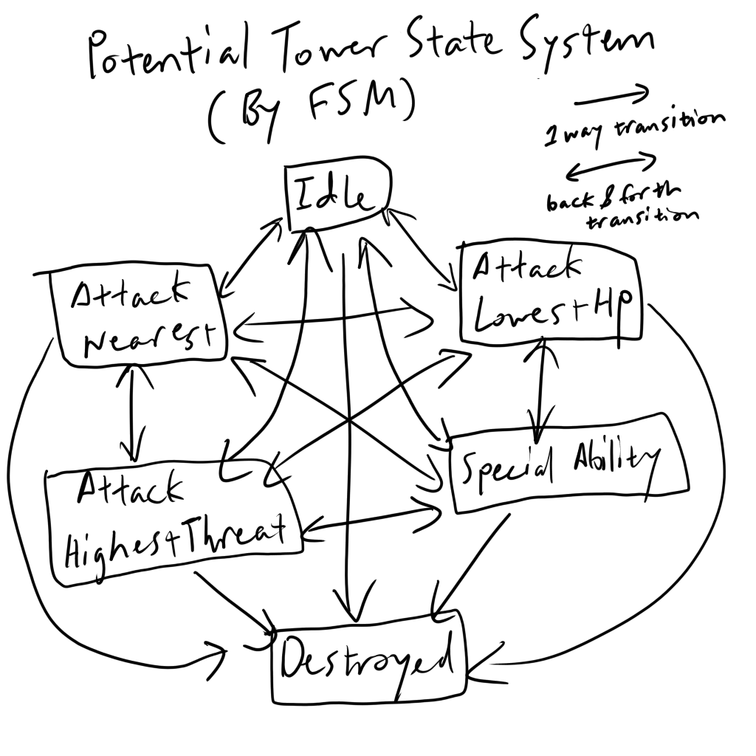
Defining The Problem (Continued)
Each arrow (transition) represents a specific condition that must be satisfied to move between states. As more behaviors and factors are introduced, the number of transitions grows rapidly, making state management increasingly complex and more prone to errors.

Slide 10
Literature Review
FSMs rely on "hardcoded transitions," which work for simple designs but become less suitable as game AI grows more complex and dynamic, noting that FSMs are also "pretty limited" even with "common extensions," making them difficult to scale for modeling complex behaviors (Nystrom, 2014).
As FSMs grow, "the number of states starts to increase rapidly," making them harder to manage, since even small changes require considering "all of its dependent transitions" (Jagdale, 2021).
Defense towers in RTS games traditionally attack the nearest enemy without evaluating important factors, making their behavior predictable and easily exploited by coordinated enemy waves (Fauzi et al., 2019).

Slide 11
Experimentation - Materials and Methods
The experiment was conducted through a real-time strategy (RTS) tower defense simulation designed to test AI performance against escalating enemy waves. The materials used included three types of defensive towers, Kamandaka, Adikara, and Baswara, each tasked with resisting progressively larger groups of enemy units (Fauzi et al., 2019). Tower performance was measured based on two primary metrics: Tower Health (Nyawa Tower) and Engagement Duration (Waktu), representing how much health the tower retained and how long it could endure enemy assaults.
The methods involved implementing two different AI control systems: a traditional Finite State Machine (FSM) and a Hierarchical Finite State Machine (HFSM). Each system governed how towers detected threats, prioritized targets, and executed defensive actions during the simulation. By comparing the behaviors and outcomes between FSM and HFSM-controlled towers, the experiment evaluated how hierarchical decision-making structures impacted adaptability, survivability, and overall defensive effectiveness.

Slide 12
Experimentation - Results
In order to evaluate the effectiveness of the Hierarchical Finite State Machine (HFSM) system compared to the traditional Finite State Machine (FSM) system, several simulations were conducted in a real-time strategy (RTS) tower defense scenario (Fauzi et al., 2019).
Three different types of towers were tested under waves of incoming enemy units, but for clarity, this section will focus on two representative examples: the Kamandaka Tower and the Adikara Tower.
Each tower's performance was measured based on two key factors:
Figure 3: Tower Health (Nyawa Tower): How much health the tower retained as the number of enemies increased.
Figure 5: Survival Time (Waktu): How long the tower could continue resisting enemy waves.
The selected figures highlight how the HFSM system enables towers to better adapt to enemy threats, resulting in improved survivability compared to FSM-controlled towers.
(see figures on next slide)

Slide 13
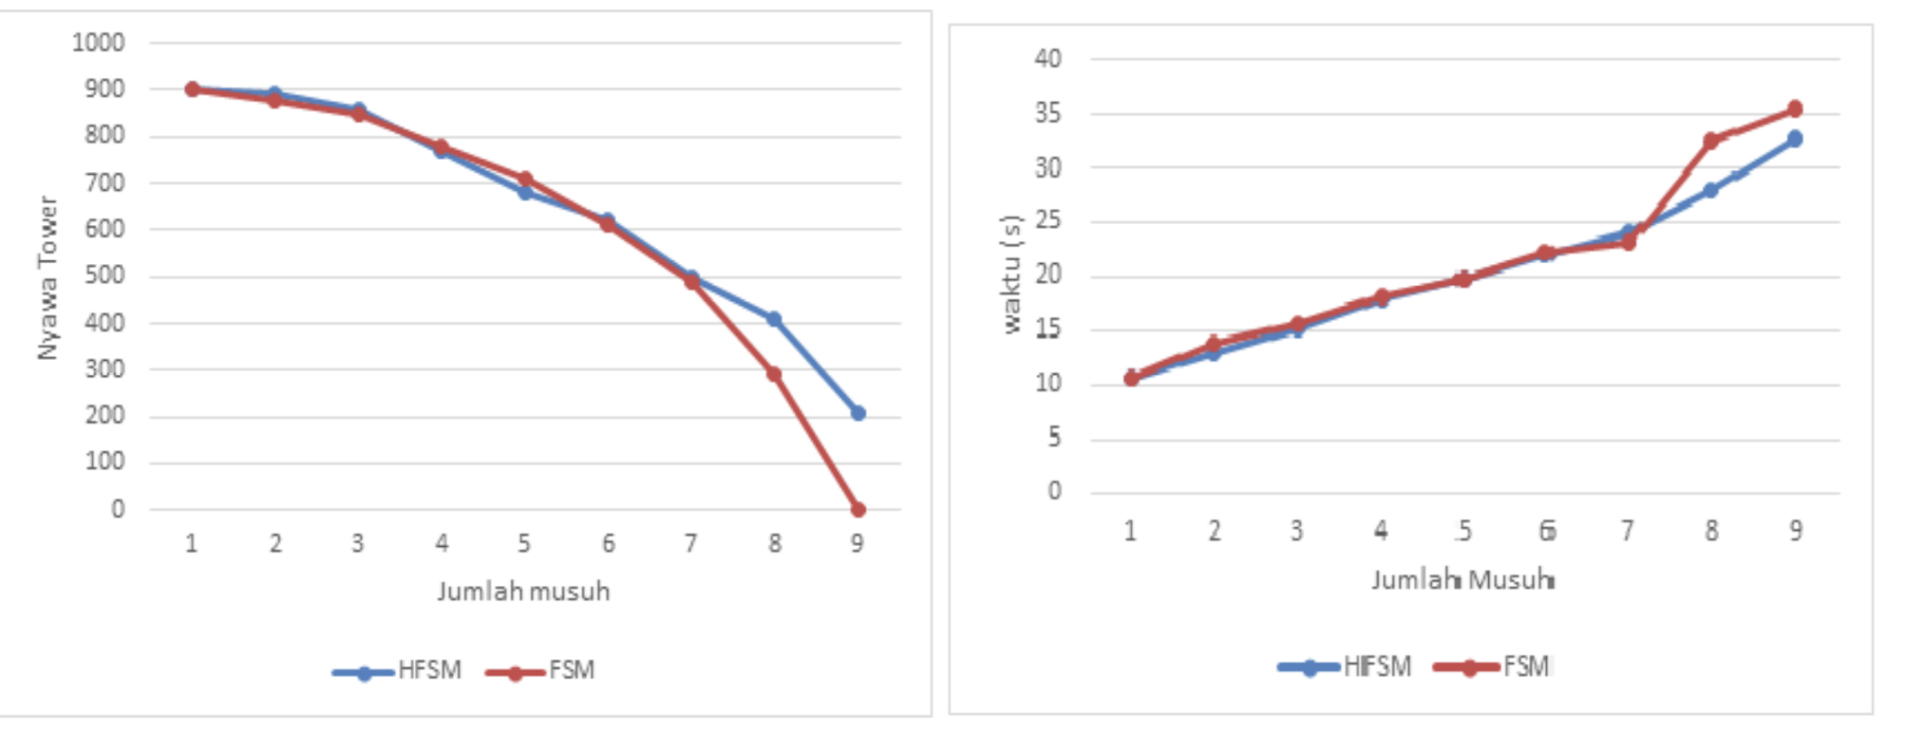
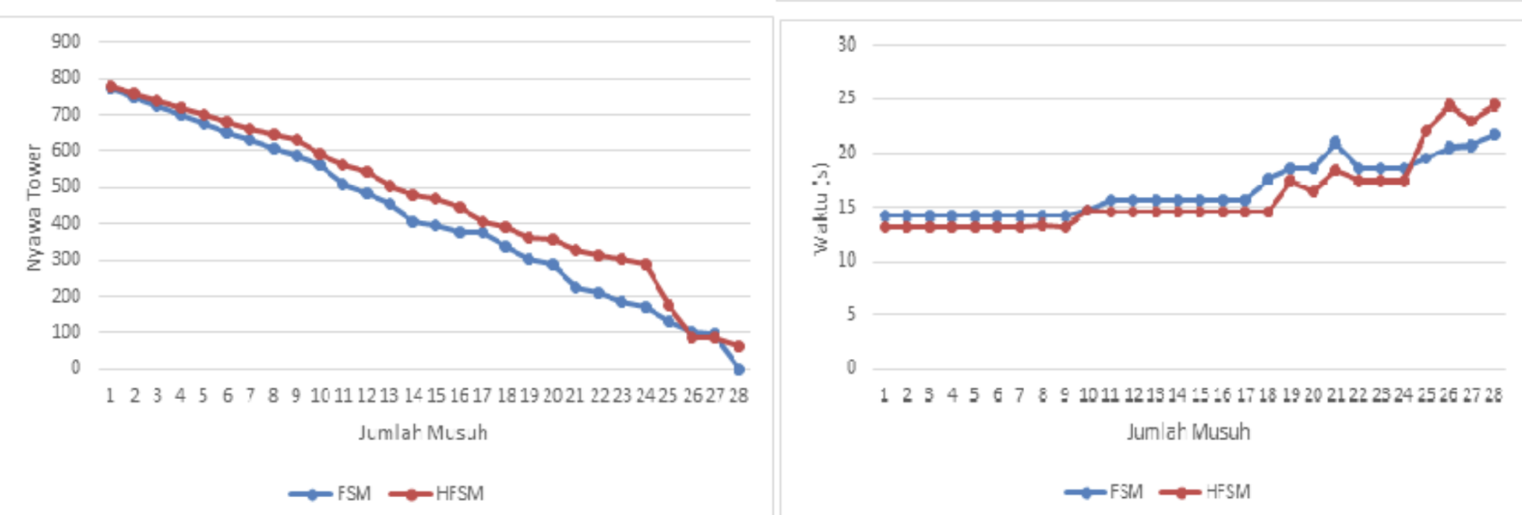
Experimentation - Results (Continued)
Figure 3: Kamandaka Tower
Key Terms for Figure Interpretation:
Nyawa Tower = Tower Health
Jumlah Musuh = Number of Enemies
Waktu (s) = Engagement Duration (in seconds)
Figure 5: Adikara Tower

Slide 14
Discussion of the Results (Kamandaka Tower)
Figure 3: Kamandaka Tower
Nyawa Tower = Tower Health
Jumlah Musuh = Number of Enemies
Waktu (s) = Engagement Duration (in seconds)
Figure 3 shows the Kamandaka Tower's performance under increasing enemy attacks. The HFSM-controlled tower consistently maintained higher health (Nyawa Tower) compared to the FSM tower, which dropped to zero health much earlier. Although the FSM tower had a slightly longer engagement duration (Waktu), it also survived with critically low health. In this case, the HFSM tower’s shorter engagement was the result of eliminating enemies more efficiently and surviving, not from being defeated earlier.

Slide 15
Discussion of the Results (Adikara Tower)
Figure 5: Adikara Tower
Nyawa Tower = Tower Health
Jumlah Musuh = Number of Enemies
Waktu (s) = Engagement Duration (in seconds)
Figure 5 presents the Adikara Tower's performance against a larger number of enemy units. The HFSM-controlled tower consistently maintained higher health (Nyawa Tower) compared to the FSM tower as the battle progressed. Even though the HFSM tower had a longer engagement duration (Waktu), it reflects that the FSM tower was eliminated earlier, while the HFSM tower continued fighting and surviving under heavier enemy waves.

Slide 16
Discussion of the Results (Overall)
The experiment results shown in Figure 3 and Figure 5 demonstrated that:
HFSM towers consistently maintained higher health across increasing enemy waves, allowing them to absorb more damage and survive tougher engagements.
HFSM displayed superior adaptability and efficiency compared to FSM, either clearing enemies faster or enduring longer depending on battlefield conditions.
In the Kamandaka Tower case (Figure 3), the HFSM tower’s shorter engagement duration resulted from eliminating enemies more efficiently and surviving, not from being defeated earlier.
In the Adikara Tower case (Figure 5), the HFSM tower exhibited greater endurance, surviving under continuous enemy pressure while the FSM tower was eliminated earlier.
FSM exhibited rigid and predictable behavior, making it easier for enemies to exploit weaknesses.
Overall, HFSM offers a smarter, more flexible, and more sustainable defense strategy for RTS tower AI, overcoming the scalability and adaptability limitations of traditional FSM approaches.

Slide 17
Conclusions
As games continue to grow in complexity, the need for smarter and more adaptable systems has become increasingly important. Traditional FSMs often struggle to keep up with changing player strategies and evolving gameplay situations, which can make games feel predictable and repetitive. HFSMs offer a better way to manage this complexity by creating more flexible and responsive behaviors. This idea reflects a broader trend in game development, where systems need to balance structure with adaptability to stay effective as games change. Using hierarchical models not only makes it easier to design scalable systems, but also helps create more engaging and long-lasting gameplay experiences that keep players interested over time.

Slide 18
Future Research/Future Directions
If I were the author, the potential options are:
Explore derivative extensions of traditional FSM and HFSM models, such as Behavior Trees (BT) or Utility AI, to improve decision-making flexibility and create more adaptable NPC behaviors.
Investigate hybrid architectures that combine HFSM with adaptive learning algorithms, allowing AI systems to adjust dynamically to complex or unpredictable gameplay environments.
Develop upgraded versions of HFSM capable of managing larger, multi-agent systems with intricate state dependencies, enabling better coordination and more realistic group behaviors.
Research advanced techniques like Behavior Trees to streamline state transitions, improve AI decision flow, and design NPCs that can react more smoothly and intelligently to player actions.

Slide 19
Acknowledgments
I would like to thank the team I worked with during my game development internship, where I first learned how to design and implement FSM for real gameplay systems. Their hands-on guidance not only helped me understand the basics of state-based behavior, but also gave me insight into how FSMs are used to create responsive and dynamic game characters. I also want to thank the author(s) of the article for providing a detailed breakdown of FSMs and introducing HFSMs, which offered a deeper understanding of how structured decision-making can be improved to handle more complex gameplay situations. Both experiences were important in shaping the knowledge and ideas that went into this project.

Slide 20
Bibliography/References
Fauzi, R., Hariadi, M., Nugroho, S. M. S., & Lubis, M. (2019). Defense behavior of real-time strategy games: Comparison between HFSM and FSM. Indonesian Journal of Electrical Engineering and Computer Science, 13(2), 634–642. https://doi.org/10.11591/ijeecs.v13.i2.pp634-642
Jagdale, D. (2021). Finite state machine in game development. International Journal of Advanced Research in Science, Communication and Technology, 10(1), 384–390. https://doi.org/10.48175/IJARSCT-2062
Nystrom, R. (2014). Game programming patterns: State. Retrieved April 10, 2025, from https://gameprogrammingpatterns.com/state.html

